Slide 1
Opening a restaurant in Munich

Slide 2
Description of the problem
Alex wants to open a restaurant in Munich, he is experienced in Indian, Asian and Italian food and can not decide which of these restaurants he should open, so he can make more profit. So he wants to analyze the district around the store he owns and find the best possible solution to open his restaurant.

Slide 3
Description of the data
Data from Foursquare will help him to identify the most common restaurant in each area, after clustering the areas suggestions will be made to find out what kind of restaurant is missing or is better to open in that area through Machine learning. As the API for Foursquare in the regular mode is restricted, the decision making will just be based on the distance and types of restaurant around his defined stores.

Slide 4
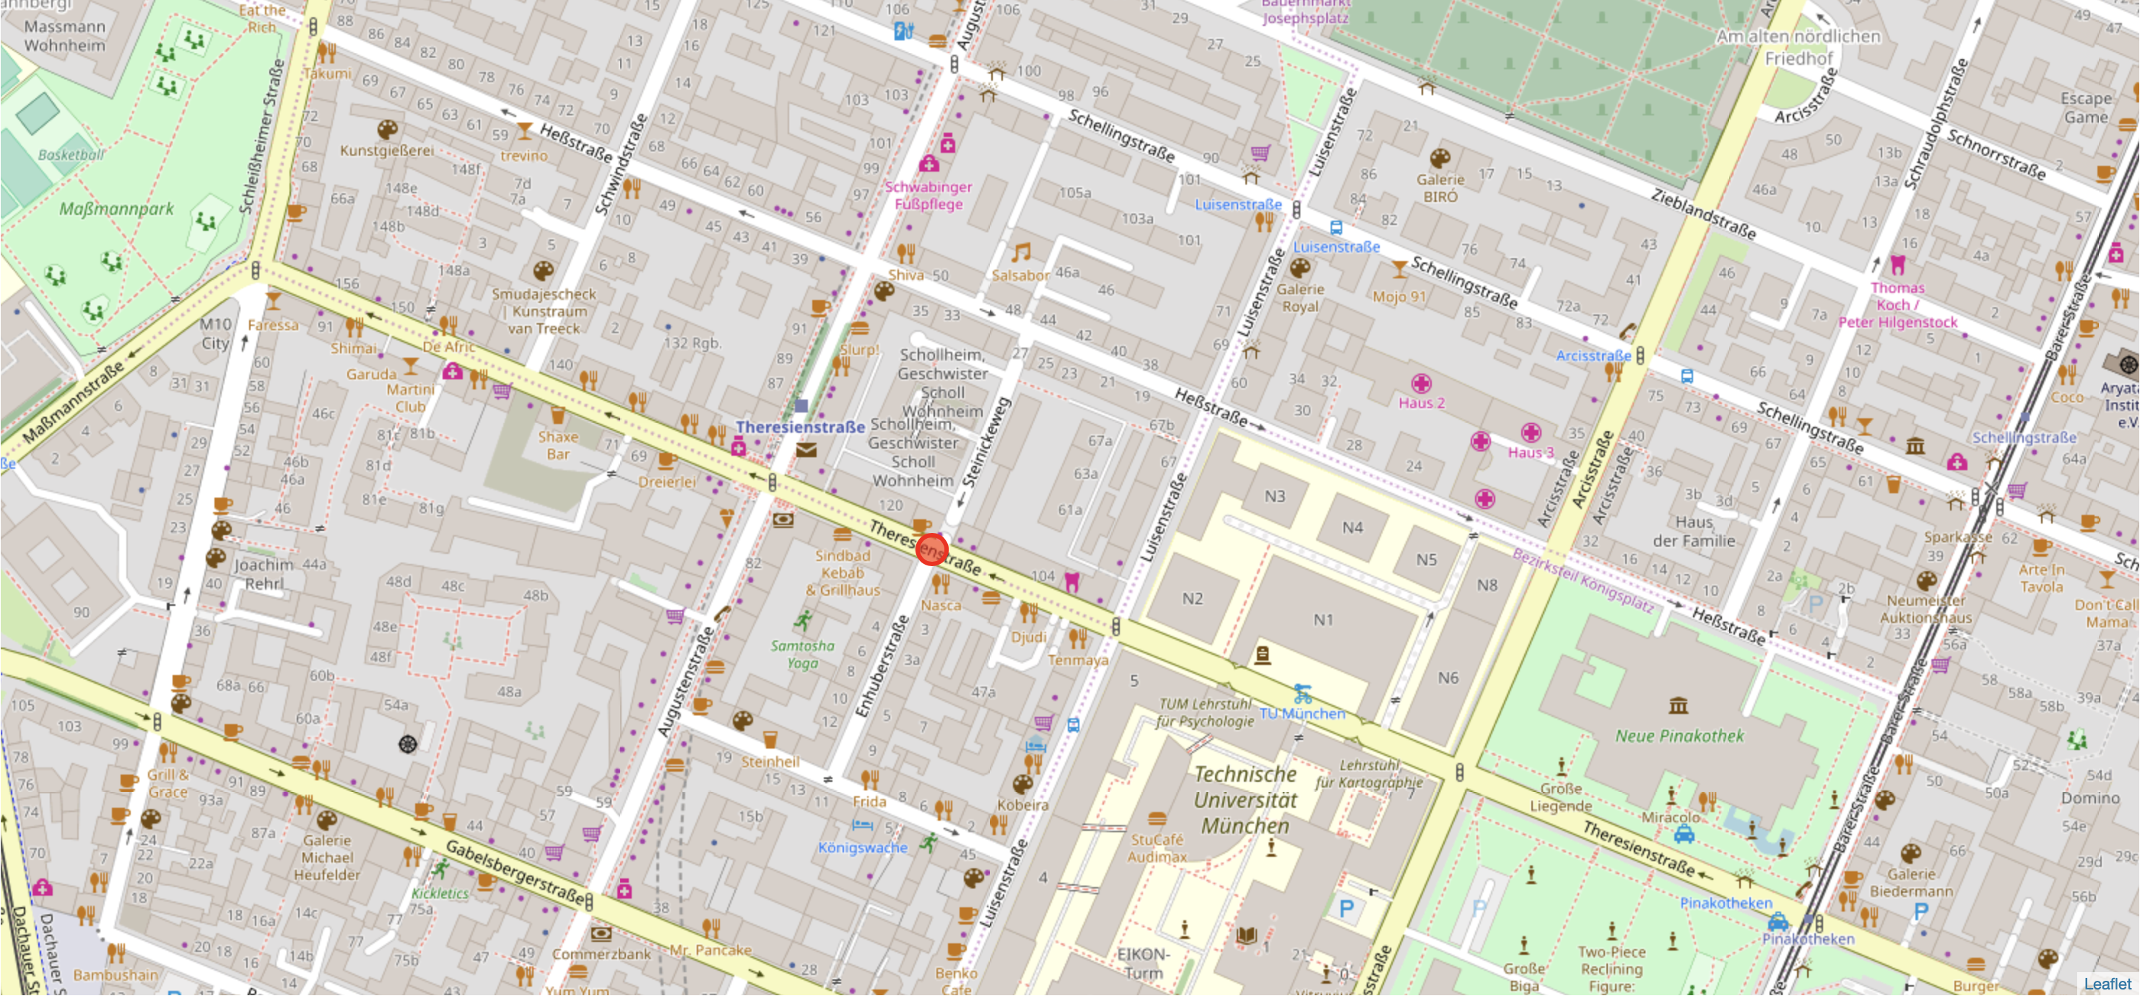
Address of the restaurant The store is located in theresienstrasse in Munich, Germany

Slide 5
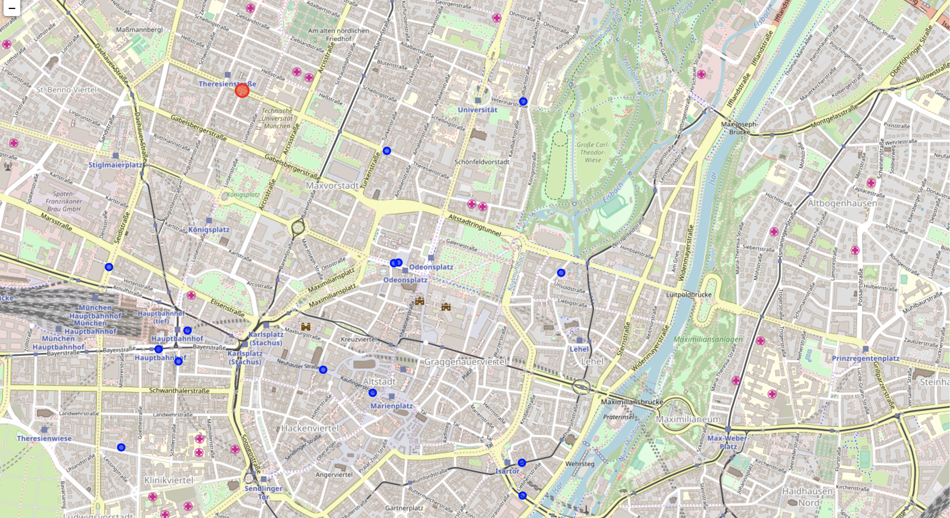
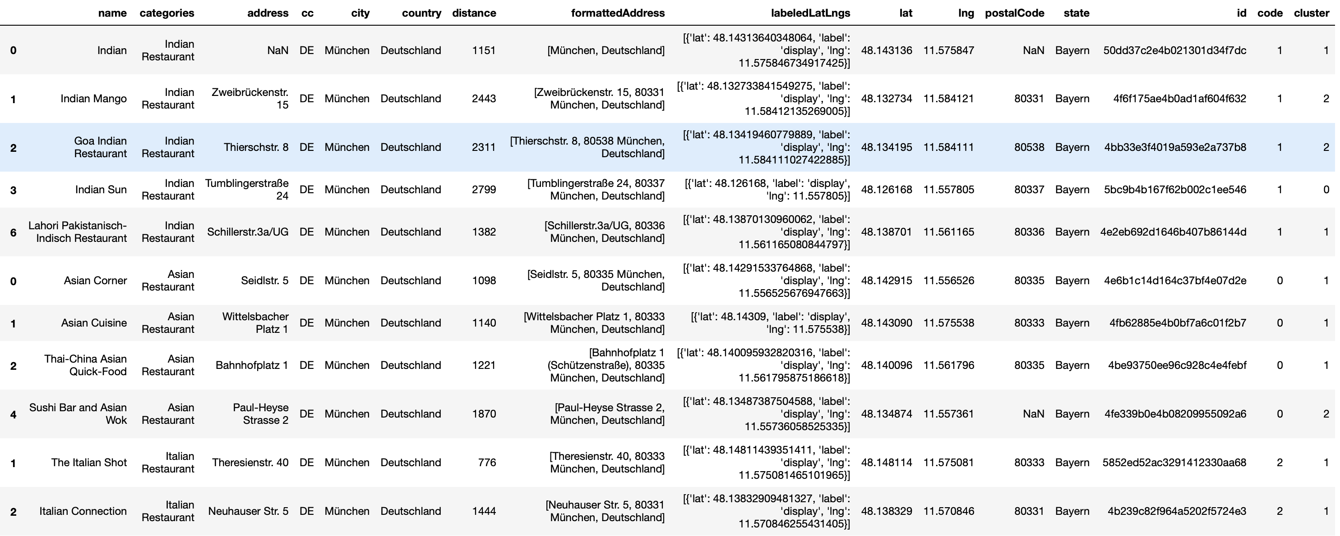
Restaurants around our store in a radius of 2km
There are 17 asian, indian, italian restaurants around our store (marked as blue)
Many Restaurants have been filtered out because they werde either not in this type or wer not registered on foursquare
Dataframe showing the restaurants

Slide 6
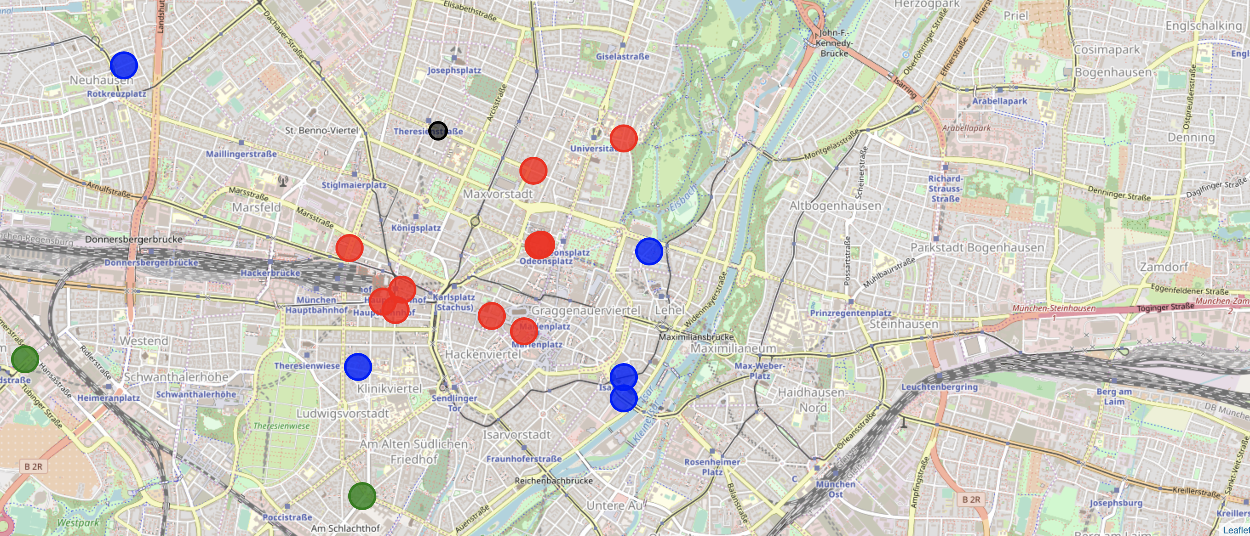
Using K-Means to Cluster the restaurants in groups for decision making
Our store
The clustering is based on distance to our store and the type of the restaurants
Different clusters illustrated in Red, Blue and Gree

Slide 7
Conclusion
Analysing the clusters show that in the red cluster there is only one indian food, and that italian and asian food are the favorites around the store.
The green and blue cluster have the most indian restaurant which have a larger distance
A lack of indian restaurants around our store could be a good opportunity to open an indian restaurant

Slide 8
Limitation and further work
Data from foursquare in Munich is incomplete as the app is not used by many users
Most of the venues have no ratings or tips which could be analysed for this project
Many of the restaurant around our store were not registered on foursquare which means we need more data for decision making

Slide 9
Thank you for your attention!

